Slide 1
EDUC 15: Statistics for Education Research
Lecture 3
School of Education
UCI

Slide 2
Measure of Central Tendency
Mode: the most frequent value in a group is the mode.
Median: the median is a set of scores' midpoint.
Mean: the mean is the average, and more affected by extreme scores, or outliers.

Slide 3
Choosing Measures of Center
and Spread
Choosing Measures of Center and Spread
Median, five number summary and IQR usually better than the mean and standard deviation for describing a skewed distribution or a distribution with outliers
Use mean and standard deviation only for reasonably symmetric distributions that don’t have outliers.
NOTE: Numerical summaries do not fully describe the shape of a distribution. ALWAYS PLOT YOUR DATA!

Slide 4
Mean
Average is another name for mean
If describing a population, denoted as μ, the greek letter “mu”.
If describing a sample, denoted as X, called “x-bar”. In SPSS the mean is denoted by M
Seriously affected by unusual values called “outliers”.

Slide 5
Median
Another name for 50th percentile.
Appropriate for describing measurement data.
“Robust to outliers,” that is, not affected much by unusual values.

Slide 6
Mode
The most frequent value of the data
“Robust to outliers,” that is, not affected much by unusual values.
Depends on whether or not data have one (“unimodal”) or two (“bimodal”), or more (“multimodal”) modes.

Slide 7
The Effect of Outliers
If one or two observations are far from the rest of the data, these observations are called outliers.
For example: add a score of 0
93 92 88 90 0
Mean change from 90.75 to 72.6
The median nearly unaffected ( 0 88 90 92 93)
Median less affected by outliers than mean

Slide 8
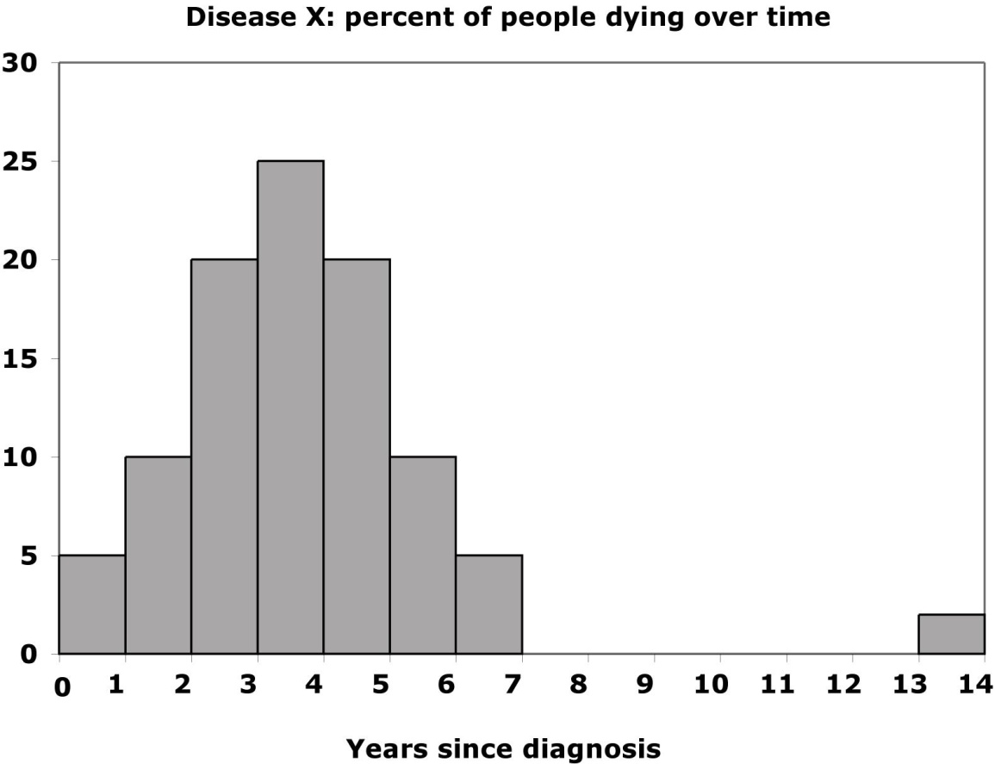
Mean and median of a distribution with outliers
Weekly commuting time to school
Commuting time to school: hours per week
Frequency
distribution
Without the outliers
Percentage of students
Percent of people dying
With the outliers
Hours per week
The mean is pulled to the right a lot by the outliers (from 3.4 to 4.2).
The median, on the other hand, is only slightly pulled to the right by the outliers (from 3.4 to 3.6).

Slide 9
Measures of Variability
Measures of variability, or dispersion, are the statistical companions to central tendency values.
They indicate how much scores tend to differ from one another.
Small measures of variability indicate that scores are generally quite similar.
Larger measures of variability indicate more difference among the scores. How spread out the data are has an important influence on the way we analyze and understand them.

Slide 10
The variance is the sum of the squared score-to-mean differences divided by n −1.
The standard deviation is its square root.

Slide 11
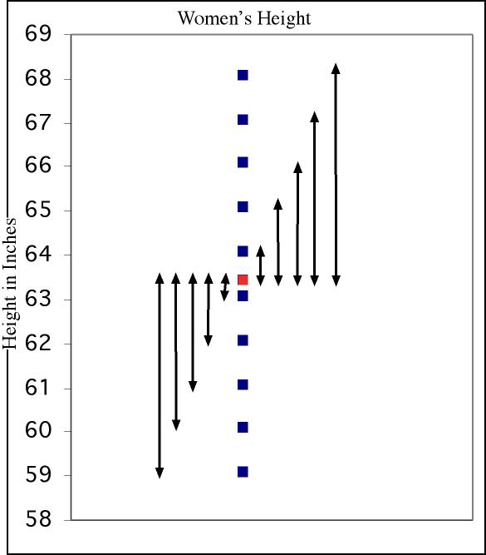
Measure of spread: the standard deviation
The standard deviation “s” is used to describe the variation around the mean. Like the mean, it is not resistant to outliers.
1. First calculate the variance s².
2. Then take the square root to get the standard deviation s.
Mean
± 1 s.d.

Slide 12
Variance
Variance from Population
Variance from the sample

Slide 13
Calculating the Variance
s² = the variance
SD = standard deviation of the sample
𝜎² = standard deviation of the population Σ = the sum of
x_{i} = each score from the 1st to the “ith,” or last score
n = the number of scores in the sample
n - 1 = df

Slide 14
Calculating the Variance
Determine the mean for the group, M
Determine the difference between each individual score and the mean, from the first number (x), to the last or “i^{th}” number, x_{i}
Square the difference between each individual score and the mean of the sample (this ensures no negative values)
Sum the squared differences
Divide by the number of observations -1: n-1

Slide 15
Degrees of Freedom
N represents the number of an entire population
n represents the number in a sample
Samples usually underestimate the amount of variation in a population
Dividing by n-1 instead of n for the unbiased sample variance

Slide 16
Standard Deviation (SD): Test score Example
4 scores: 90, 92, 88, 93
Calculate the mean first (M = 90.75)
Make this table:
Mean | X | Xi - M | (Xi-M)^2
90.75 | 90 | -0.75 | 0.5625
90.75 | 92 | 1.25 | 1.5625
90.75 | 88 | -2.75 | 7.5625
90.75 | 93 | 2.25 | 5.0625
Sum of square differences
Divid by n-1
Take the square root
Variance
Standard Deviation (SD)

Slide 17
Standard Deviation (SD): Test score Example
4 scores: 90, 92, 88, 93
Calculate the mean first (M = 90.75)
Make this table:
Mean | X | Xi - M | (Xi-M)^2
90.75 | 90 | -0.75 | 0.5625
90.75 | 92 | 1.25 | 1.5625
90.75 | 88 | -2.75 | 7.5625
90.75 | 93 | 2.25 | 5.0625
Sum of square differences |  |  | 14.75
Divid by n-1 |  |  | 4.9167
Take the square root |  |  | 2.2174
Variance
Standard Deviation (SD)

Slide 18
In-Class Practice

Slide 19
As the district's human resources specialist, you have been asked to analyze data on the ages of special education teachers in the district. For a sample of 10 you find them to be as follows: 24, 25, 28, 28, 31, 36, 39, 40, 53, 54. If a new teacher with age 30 is added, what happens to the standard deviation?
Increase
Decrease
No Change
Unknow

Slide 20
A group of students have completed a history test and answered the following number of test items correctly: 23, 27, 31, 33, 34, 34, 35, 37, 40, 45. If a 35 were added to the data in item 11, what would happen to the value of the stand and deviation?
A. Increase
B. Decrease
C. No Change
D. Unknow

Slide 21
The variance is the square root of the standard deviation.
True
False

Slide 22
The standard deviation gives one a sense of the average amount that individual observations vary around the mean.
True
False

Slide 23
Five-number summary
Distribution of Mean and median with outliers

Slide 24

Five-number summary and boxplot
Largest = max = 6.1
BOXPLOT
Q₃= third quartile
= 4.35
Hours per week
M_{dn} = median = 3.4
Q₁= first quartile
= 2.2
Commuting
Five-number summary:
min Q₁ M_{dn} Q₃ max
Smallest = min = 0.6

Slide 25
Range = R
Range
The distance from the largest to the smallest number.
Example: test scores: 70 83 83 83 90 90 94 95 95
The range is calculated by subtracting the smallest value (70) from the largest value (95): R = 25

Slide 26
How to Calculate the Quartiles and the Interquartile Range
To calculate the quartiles:
Sort the observations and locate the median M.
The first quartile Q₁ is the median of the observations located to the left of the median.
Also p25
The 2nd quartile (Q2) is the point below which 50% of the scores occur (P₅₀). It is also the median.
The third quartile Q₃ is the median of the observations located to the right of the median
Also p75
The interquartile range (IQR) is defined as: IQR = Q₃ – Q₁. Semi-quartile Range = IQR/2
Example: 10 ages:
25 33 35 38 48 55 55 55 56 64
Q₁
IQR= (55-35)= 20
M_{dn}=(48+55)/2=51.5
Q₃

Slide 27
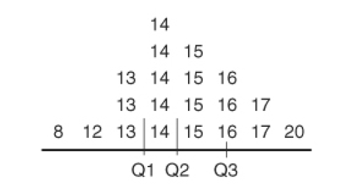
The science students’ test score are the following:
13, 14, 8, 16, 17, 13, 16, 14, 20, 14, 12, 15, 17, 15, 17, 15, 14, 15, 13, 16, 14, 15
If the scores are arranged from smallest to largest and repeated score are stacked vertically, the results is a frequency distribution.
There are five scores in each quartile (20/4)
The 5th score is a 13, and 6th a 14, Q₁ occurs at 13.5 = [(13+14)/2].
The 10th score is a 14 and 11th a 15. Q₂ (M_{dn}) occurs at 14.5.
The 15th score is a 16 and the 16th score is also 16, so Q₃ occurs at 16.
The interquartile range is 2.5, that interval from 13.5 to 16.
The semi-interquartile range is 1.25 [(16-13.5)/2].

Slide 28
Distribution of a Variable
To examine a single variable, we graphically display its distribution.
The distribution of a variable tells us what values it takes and how often it takes these values.
Distributions can be displayed using a variety of graphical tools. The proper choice of graph depends on the nature of the variable.

Slide 29
The Frequency Distribution
A frequency distribution displays the different values of data and the frequency with which each value occurs
Should be ordered
Can be used for qualitative (categorical) and quantitative data
A grouped frequency distribution includes class intervals in which data are grouped together.
A grouped frequency distribution is used rather than listing out individual data.

Slide 30
Frequency distribution table: Education Among Young Adults (age: 24-34)
Education | Count (millions) | Percent
Less than High School | 4.7 | 12.3
High School Graduate | 11.8 | 30.7
Some College | 10.9 | 28.3
Bachelor’s Degree | 8.5 | 22.1
Advanced Degree | 2.5 | 6.6
Total | 38.1 | 100

Slide 31
Guidelines
Conventions of a grouped frequency distribution:
The groups must have equal ranges.
A particular score or observation can fit into only one group.
What is displayed on a frequency distribution table:
Frequency (raw count)
Relative Frequency (proportion)
Cumulative Relative Frequency (cumulative proportion)

Slide 32
Example
Example: Smarter Balanced Board Consortium Score (Math Scale Score)
Grade 8
Levels | Intervals | Frequency
Far Below Basic | Less than 2281 | 4
Below Basic | 2281- 2486 | 9
Basic | 2487 - 2566 | 12
Proficient | 2567 - 2667 | 3
Advanced | 2668 - 2769 | 5

Slide 33
Class A SBAC Math 2019 Score Distribution
 |  | Frequency | Percent(%) | Relative Frequency | Cumulative Percent
Valid | Far Below Basic | 4 | 12.1 | 12.1 | 12.1
 | Below Basic | 9 | 27.3 | 27.3 | 39.4
 | Basic | 12 | 36.4 | 36.4 | 75.8
 | Proficient | 3 | 9.1 | 9.1 | 84.8
 | Advanced | 5 | 15.2 | 15.2 | 100.0
 | Total | 33 | 100.0 | 100.0
12.1% + 27.3%= 39.4%
12/33= 36.4%
The second column contains the same frequency values.
The third column contains the total that occur in the particular interval.
The fourth column contains the frequencies accumulate.

Slide 34
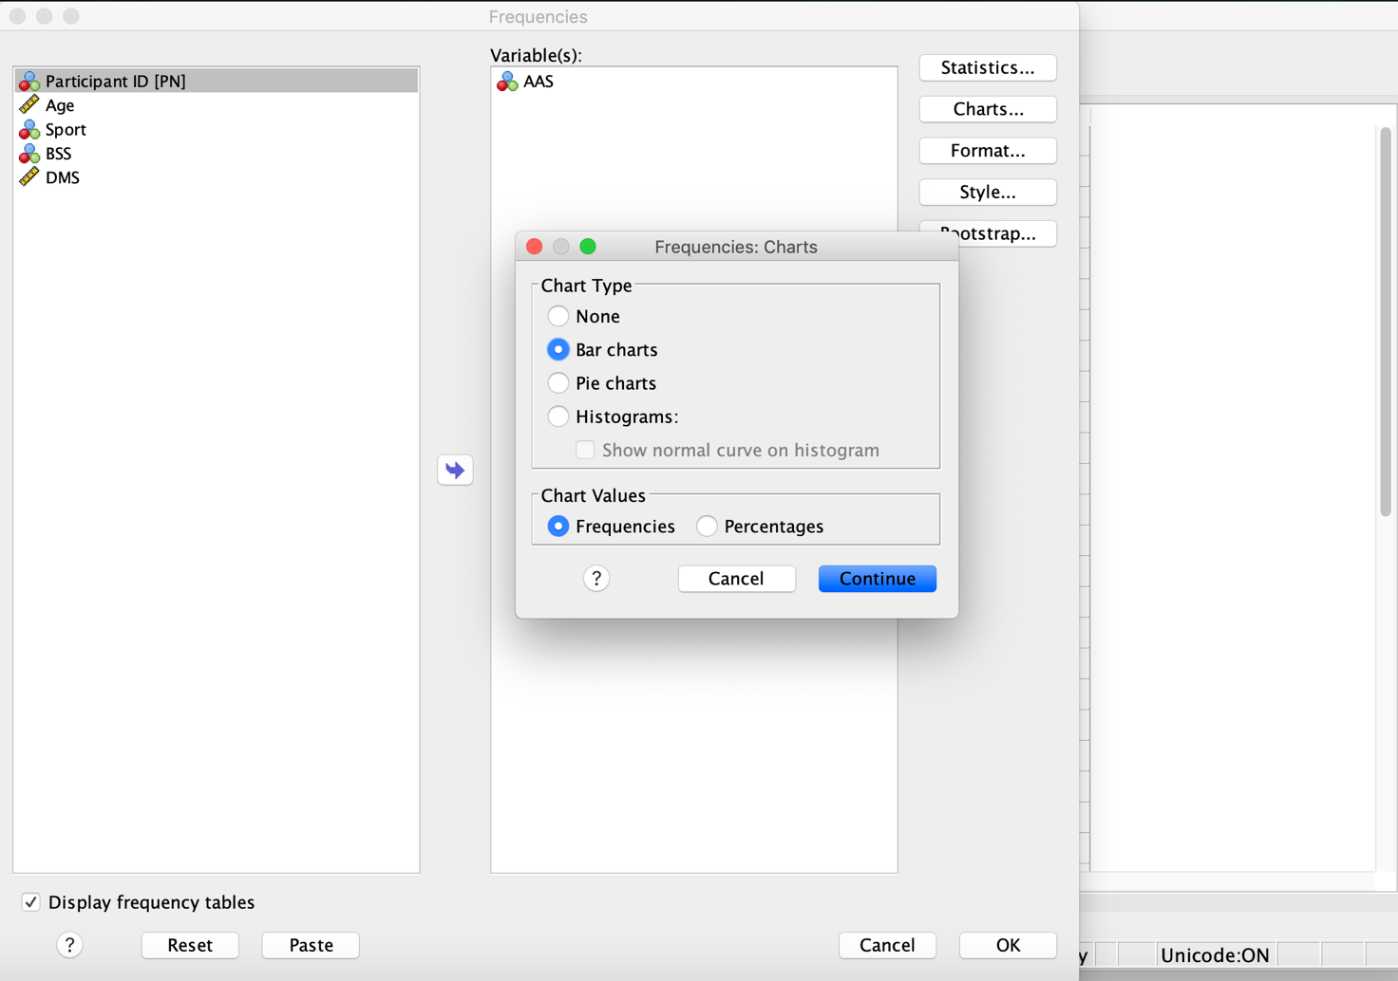
More SPSS output Bar Charts

Slide 35
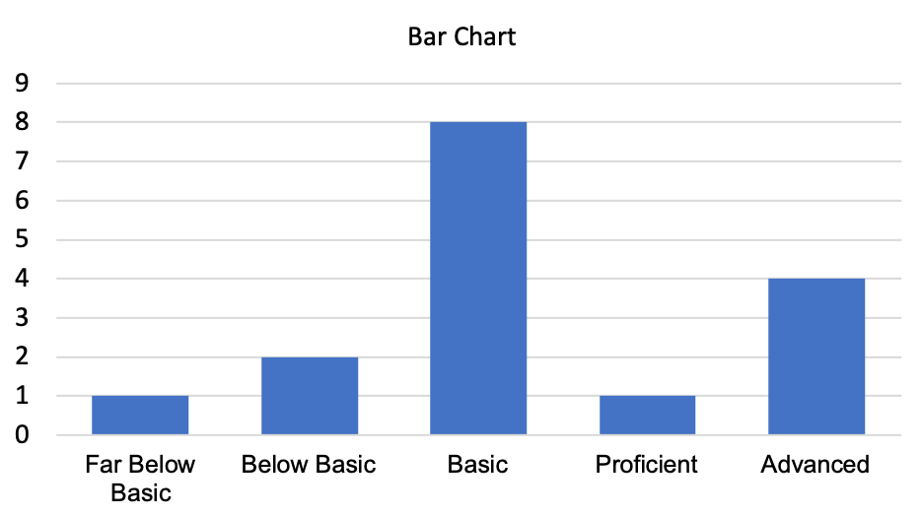
Figure 1. Class A Students SBAC Math Scale
Bar Chart clarify proportions between different classes or groups, a pie chart is often more helpful than a table of numbers

Slide 36
Data in a Grouped Frequency Distribution
Example data from a set of passing test scores:
65 70 71 72 78 79 80 81 83 84 85 87 90 90
91 91 93 95 97 98 98 99 99 100 100 100
Total: 26

Slide 37
In-class Practice
What is the value for the red question mark (?)?
0.16
0.21
0.27
0.38
Total: 26

Slide 38
In-class Practice
What is the value for the red question mark (?)?
0.16
0.21
0.27
0.38
Total: 26

Slide 39
In-class Practice
What is the value for the blue question mark (?)?
0
0.46
0.27
1.00
Total: 26

Slide 40
In-class Practice
What is the value for the blue question mark (?)?
0
0.46
0.27
1.00
Total: 26

Slide 41
Cross-Tabulation
The grouped frequency distribution can be recognized by SPSS using the “cross tabs” option under “descriptive statistics,”
Example:
Cross-Tabular Presentation of Students' Gender and Their Level of SBAC Math Score on Class A
The Cross-Tabular shows the student's performance level in the rows and the gender on columns.

Slide 42
Cross tabular Data
Break down the Frequency Table into Groups
Levels | Intervals | Frequency | Female | Male
Far Below Basic | Less than 2281 | 4 | 3 | 1
Below Basic | 2281- 2486 | 9 | 7 | 2
Basic | 2487 - 2566 | 12 | 4 | 8
Proficient | 2567 - 2667 | 3 | 2 | 1
Advanced | 2668 - 2769 | 5 | 1 | 4

Slide 43
 |  | Gender * SBAC Math Levels Crosstabulation |  |  |  |  |  | Total
 | Count | Male | Relative Frequency | Cumulative Frequency | Female | Relative Frequency | Cumulative Frequency
SBAC Math Levels | Far Below Basic | 3 | 0.18 | 0.18 | 1 | 0.06 | 0.06 | 4
 | Below Basic | 7 | 0.41 | 0.59 | 2 | 0.13 | 0.19 | 9
 | Basic | 4 | 0.23 | 0.82 | 8 | 0.50 | 0.69 | 12
 | Proficient | 2 | 0.12 | 0.94 | 1 | 0.06 | 0.75 | 3
 | Advanced | 1 | 0.06 | 1.00 | 4 | 0.25 | 1.00 | 5
 | Total | 17 | 1.00 |  | 16 | 1.00 |  | 33
Interpreting Tables and Figures
Example
There are almost 12% of proficient male learners in Class A.

Slide 44
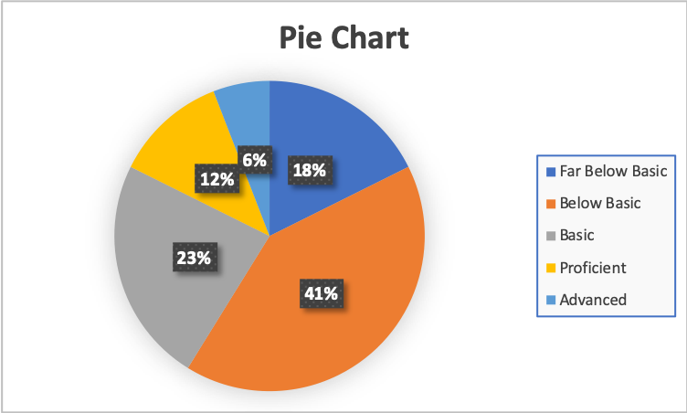
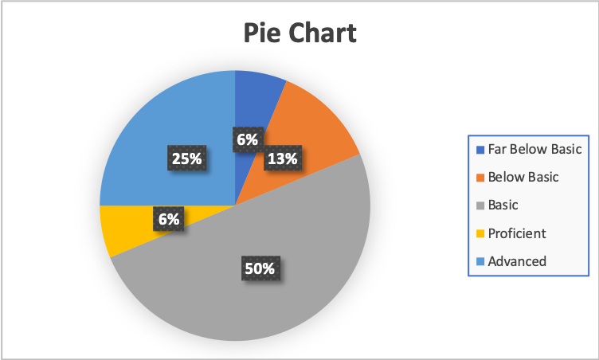
Figure 2. Male Students SBAC Math Scale of Class A
Figure 3. Female Students SBAC Math Scale of Class A
Pie charts and bar charts are both used to represent proportional differences in data categories, either by triangular wedges or with bars of different sizes.

Slide 45
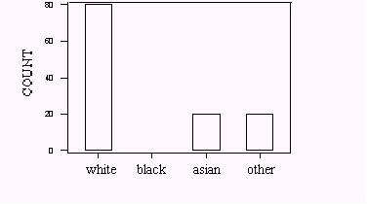
I-clicker question
In-class Practice
A sample of 160 workers in the downtown area classified each worker by race. A bar graph of the results is given below, but the bar for blacks in the graph below has been omitted.
Using the information provided, the proportion of black workers in the sample must be:
a. 40%
b. 25%
c. 20%
80
60
40
20
0
?

Slide 46
I-clicker question
In-class Practice
A sample of 160 workers in the downtown area classified each worker by race. A bar graph of the results is given below, but the bar for blacks in the graph below has been omitted.
Using the information provided, the proportion of black workers in the sample must be:
a. 40%
b. 25%
c. 20%
80
60
40
20
0
?

